Slide 1

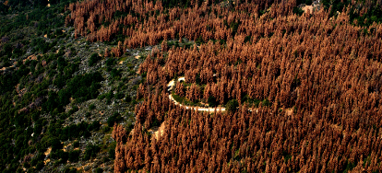
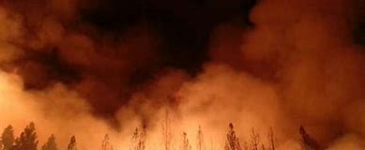
SOUTHERN CALIFORNIA EDISON
Wildfire Mitigation, Safety & Grid Resiliency
Ventura Council of Governments
September 20, 2018

Slide 2
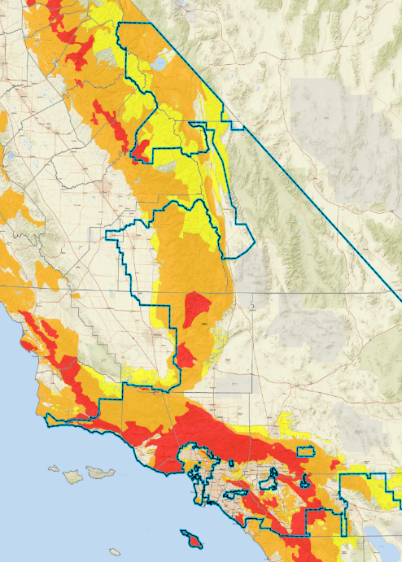
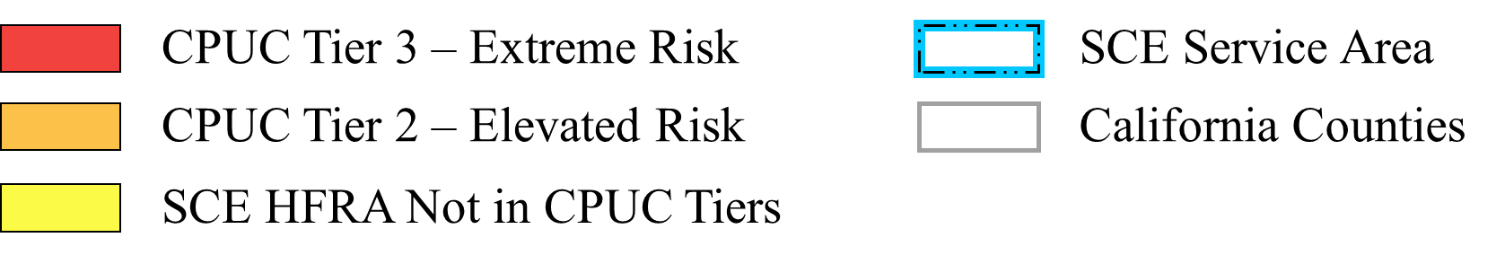
SCE Service Territory

Slide 3
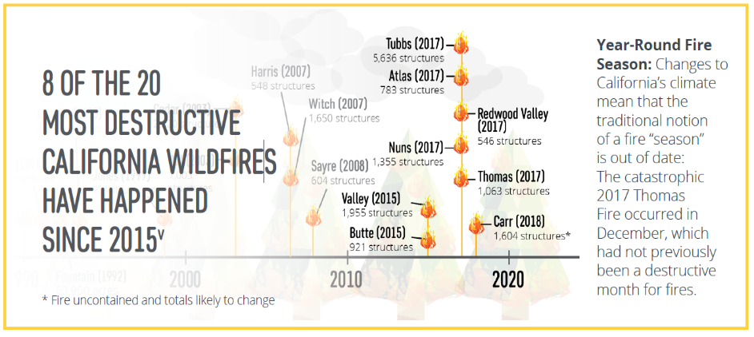
CALIFORNIA’S WILDFIRE RISK
Year-Round Fire Season: Changes to California’s climate means that the traditional notion
of a fire “season” no longer exists
Hazardous fuel is building up: 9M acres of land contain ready-to-burn kindling from nearly 129M trees that have been killed or weakened by drought and bark beetle infestation

Slide 4
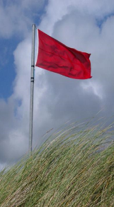
SCE’S WILDFIRE MITIGATION STRATEGY
We have long taken substantial steps to reduce the risk of wildfires, and we continue to proactively enhance our operational practices and infrastructure through our comprehensive wildfire mitigation strategy
Long-Standing Operational Practices
Enhancing Operational
Practices
Investing in
System Hardening
of Electric Grid
Bolstering
Situational Awareness Capabilities

Slide 5
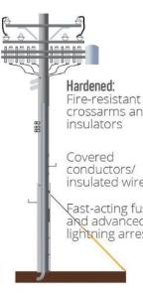
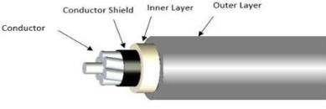
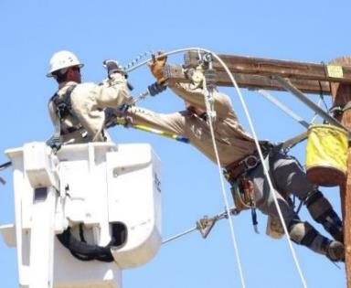
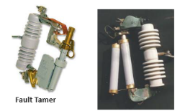
SYSTEM HARDENING ELEMENTS
Hardened System
Covered Conductor
Insulated Wires / Covered conductors
Fast-acting fuses
Fire-resistant poles, crossarms and insulators
Fast-Acting Fuses

Slide 6
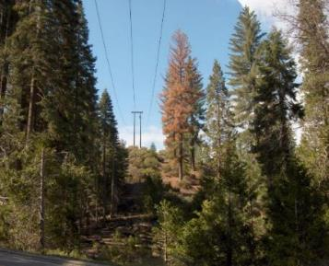
VEGETATION MANAGEMENT
  20+ in-house certified arborists
  800+ pruning contractors
  ≈ 900,000 trees inspected annually
  ≈ 700,000 pruned per year; 400,000 trees in high fire risk areas
  Dead, dying, diseased tree removal; total drought and bark beetle trees removed in 2017 was 39,000
  Expanding use of Light Detection and Ranging (LiDAR) technology
  Joint patrols with fire agencies
Dead, dying, diseased trees present a hazard and are removed to protect electrical facilities and eliminate risk of fire

Slide 7
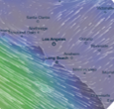
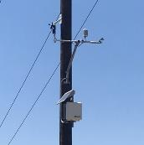
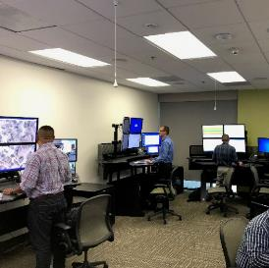
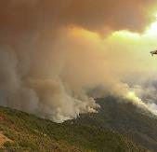
Fire and Severe Weather Monitoring
Advanced Weather Modeling
Better Forecasting
Advanced Warning
Weather Stations
Hi-Res Data
Local Weather
Situational Awareness Center
Fire Monitoring Cameras
24/7 monitoring
SCE meteorologists
High-Definition
Remote-controlled
Fire Cameras: www.alertwildfire.org
7

Slide 8
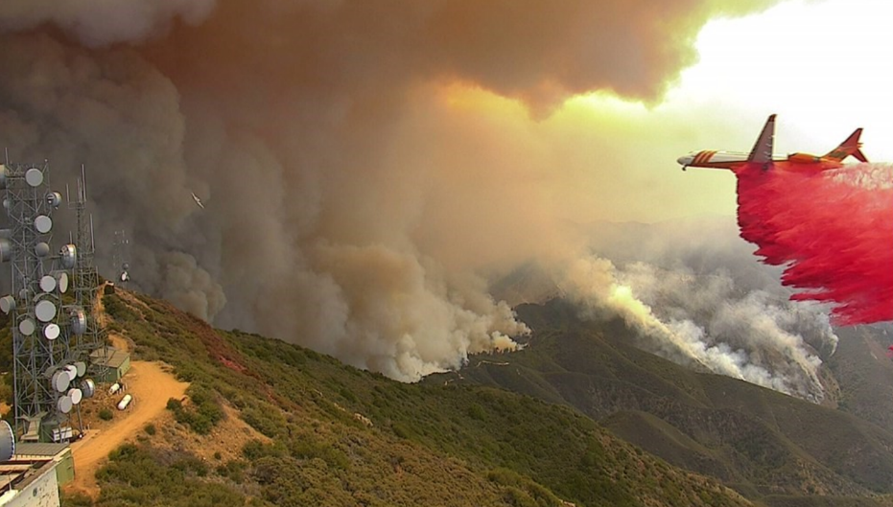
Fire and Severe Weather Monitoring
8

Slide 9
Practice of Last Resort: Public Safety Power Shutoff
  De-energization to prevent wildfire ignitions
  Used only in most extreme weather conditions
    Limited to impacted circuits in high fire risk areas
  More frequent use possible given increased wildfire risk
    Frequency and duration driven by weather
  Notifications starting 48 hours before potential power shutoff
    1st Responders, Local Governments, Water / Communications Providers, and Customers (especially critical care & medical baseline)
  Decision to de-energize considers variety of factors
    SCE will be in regular contact with fire/emergency personnel prior to decision
  Power restoration begins after local conditions have improved and safety checks have been performed
8
Notes:
Other Items to Voice Over:
Very extreme situation for SCE, who prides itself on safely delivering reliable and clean energy, to turn off the power
Other reasons power goes out: maintenance, emergency repairs, requests by Fire Agencies
Outages will only impact the specific circuits experiencing extreme weather
How often (~2-10 times/yr) across all HFRAs
How long – can range from ½ a day to a few days
Most electric circuit interruptions, or “faults,” are momentary, caused, for example, by a bird or metallic balloon making contact with power lines. Under normal conditions the grid automatically tests the circuit and, if the fault condition no longer exists, the circuit is quickly re-energized. During Red Flag conditions, affected circuits are not automatically re-energized and SCE crews physically inspect the lines before they are re-energized.
PSPS: In our operational toolkit, this is our last resort. We can do all those other things that we just mention to the best of our abilities, but extreme weather may require us to do more. Because extended power outages create additional risks for essential services and have significant impacts on utility customers, they are sparingly used. In light of increasing wildfire risk, however, SCE is evaluating the more frequent use of this measure during extreme conditions.
A Public Safety Power Shutoff (PSPS) is a practice that Southern California Edison (SCE) may use to shut off power in targeted areas during extreme and potentially dangerous weather conditions.
In considering whether to de-energize a line, SCE considers a wide variety of factors which may include, but are not limited to the following:
The National Weather Service has issued Red Flag Warnings for counties that contain SCE circuits in High Fire-Risk Areas
Ongoing assessments from the SCE in-house meteorologists regarding the local conditions related to wind speed, humidity, and temperature
Real time situational awareness information from highly trained personnel positioned locally in High Fire-Risk Areas identified as at risk for extreme weather conditions
Input from our Fire Management experts co-located with the Office of Emergency Management regarding any ongoing firefighting efforts
Specific concerns from local and state fire authorities regarding the potential consequences of wildfires in select locations
Awareness of mandatory or voluntary evacuation orders in place
Expected impact of de-energizing circuits on essential services such as water pumps, traffic controls, etc.
Other operational considerations to minimize potential wildfire ignitions
[MGE1] SCE will make every effort to notify local governments and customers ahead of time – especially our critical care and our medical baseline customers – to help them prepare for the potential de-energization. When a safety shutoff takes place, customers will see a loss of power similar to other types of outages. As conditions improve and safety checks have been performed in the field, SCE will begin to restore power depending on local conditions at the time. The order in which circuits are re-energized will depend on many factors such as safety conditions, equipment inspections, repair time, customer well-being and essential services.
We pride ourselves on service reliability and de-energizing our customers is not something we take lightly. Thus, we will only take this step if we feel that our system and our communities are safer de-energized and it is absolutely necessary for public safety.

Slide 10
Extreme Fire Conditions
Significantly increased risk of ignition
Fires can grow rapidly, burn intensely, and/or erratically
Weather Components
Fuel
Fuel Moisture
Vegetation Density and Health
Other Factors
Wind Speed and Direction
Humidity
Temperature

Slide 11
PUBLIC SAFETY POWER SHUTOFF - CONSIDERATIONS
Many factors inform decision to turn power off. Factors include but are not limited to:
  Real-time conditions
    Weather station data
    Trained field personnel in local area
  Input from fire authorities and Emergency Management Personnel
    Evacuation orders / status
    Impact on essential services
    Location of evacuation centers
    Other emergency operations

Slide 12
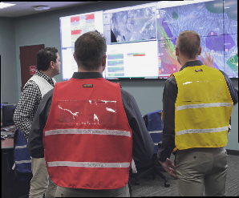

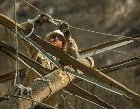

Public Safety Power Shutoff: Timeline
4-7 DAYS AHEAD
3 DAYS AHEAD
2 DAYS AHEAD
1 DAY AHEAD
POWER SHUTOFF
POWER RESTORATION
Forecast Weather & Fire Conditions
1st Notification
PSPS Possible
3rd Notification
Power Shutoff
Incident Responders On Alert
2nd Notification
PSPS Likely
4th Notification
Power Restored

Slide 13


PSPS Event Frequency and Duration Forecast
Outages predicted to last between half a day to a few days
2-10 PSPS shutoffs per year predicted
(system wide)
Predictions based on historical weather data and past PSPS events. Actual frequency and duration depends on a number of factors which cannot be forecasted with certainty
Event frequency and duration predictions across all of SCE’s high fire risk areas
Scope/impact of extreme fire conditions and time to conduct safety checks of our equipment following these conditions will affect the duration of these outages.

Slide 14
Community Resilience & Preparedness
  Power Outages Can Occur for Many Reasons
    Maintenance
    Emergency Repairs
    Requests from Fire Agencies
    Natural Disasters
  Have a Plan and Be Prepared
    Be Informed
    Plan Ahead
    Take Action
www.Ready.gov
12
Notes:
Things to think about for preparedness:
How to open your garage door
Way to charge your cell phones
Backup battery for your wifi router/modem – alternate way to get internet

Slide 15
Thank You
Rudy Gonzales-805.402.4403

